Slide 1


24th Annual TRICS® User Meeting
Changes in Travel Behaviour
Lynn Basford
BasfordPowers
London Transport Museum, Covent Garden Piazza
Tuesday 25th June 2019

Slide 2
Changes in Travel Behaviour
Would you tell me, please, which way I ought to go from here?

Slide 3
Recognising Changes in Travel Behaviour
BasfordPowers (BP) in conjunction with ITS Leeds (Professor Greg Marsden) and UWE (Professor Glenn Lyons) has been commissioned to produce a TRICS Guidance Note concerning Change in Travel Behaviour.
Scope of the commission:
  To inform TRICS users of the changes in travel behaviour.
  Trend analysis distilled from the All Change Report Commission on Travel Demand May 2018 covering travel demand, demographical changes that impact on travel choices (including aging population).
  Illustrate Scenario analysis drawing on the Department for Transport Road (DfT) Traffic Forecast 18 and CIHT FUTURES.
  To examine TRICS trend analysis of historic trip rates for the three main land-uses of Food Retail, Offices and Houses Privately Owned.

Slide 4
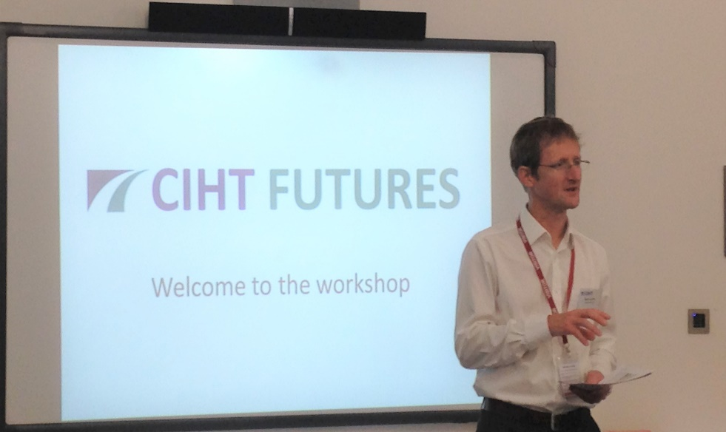
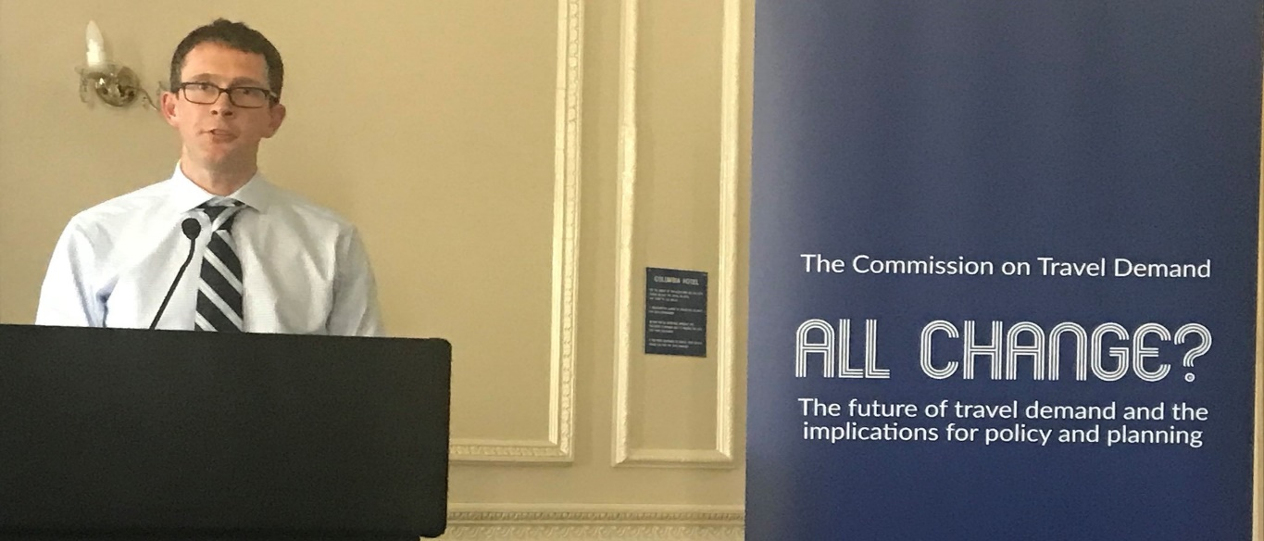
The evidence emerges…

Slide 5
Changes in Travel Behaviour
Travelling less: Evidence from the Commission for Travel Demand shows that we make 16% fewer trips than in 1996, travel 10% fewer miles than in 2002 and spend 22 hours less time travelling than we did in 2008.
Retail: Online shopping is growing at around 10-12% per annum and now represents 17% of total UK retail sales. There has been a 30% decrease in physical shopping trips over the past decade and 16% decline in distance travelled.
Socio Economics: Younger generations are travelling 20% less (17-34 years) and 35-64 year olds are travelling 10% less. These trends are expected to continue.
Travel to work: The DfT’s substantive review of travel to work trends in 2017 revealed that there has been a substantial decrease in commuting trips between 1988/92 and 2013/2014, from 7.1 journeys per worker per week down to 5.7 journeys.
Source: All Change? The future of travel demand and the implications for policy and planning The Commission on Travel Demand in May 2018

Slide 6
Changes in Travel Behaviour
Geographical differences: Shire towns, resorts and rural areas still show the highest mileage and more limited reductions than urban areas, where densities are higher and travel choices are more prevalent. Should higher densities and travel choices be provided then further reductions in travel may occur.
Changing transport technologies: The electrification of the fleet, increasingly connected and autonomous vehicles and shared mobility will all influence travel patterns. The extent of this is currently unknown and the DfT recognise this in its RTF18 report. Reductions in travel costs per mile will influence travel behaviour and have the propensity to increase vehicle miles.
Cycling and walking: The number of miles cycled in 2016, 3.5 billion, is around 23% above the figure ten years before, and 6.3% more than the miles cycled in 2015. According to the NTS data, walking trips under 1 mile have gone up 23% between 205 and 2017.
Rail travel: There has been an increase in rail trips by 56% and a 23% increase in the distance travelled by rail which continued through the recession period
Source: All Change? The future of travel demand and the implications for policy and planning The Commission on Travel Demand in May 2018

Slide 7
Changes in Travel Behaviour
Road Traffic Forecasts 2018 Department for Transport
  This report sets out a significant change in direction by the DfT in forecasting as the DfT has used scenario planning to:
  “to construct a number of different plausible future outcomes. This provides a strategic view of key uncertainties that might impact on future road traffic and supports the design of strategies and policies that are resilient to these uncertainties.”
  7 scenarios presented in RTF18
  Extrapolated Trip Rates (scenario 6) recognises the uncertainty in future trip rates and extrapolates this recent trend (2011 to 2016) in trip rates to 2050 to understand how this might impact on traffic growth.

Slide 8
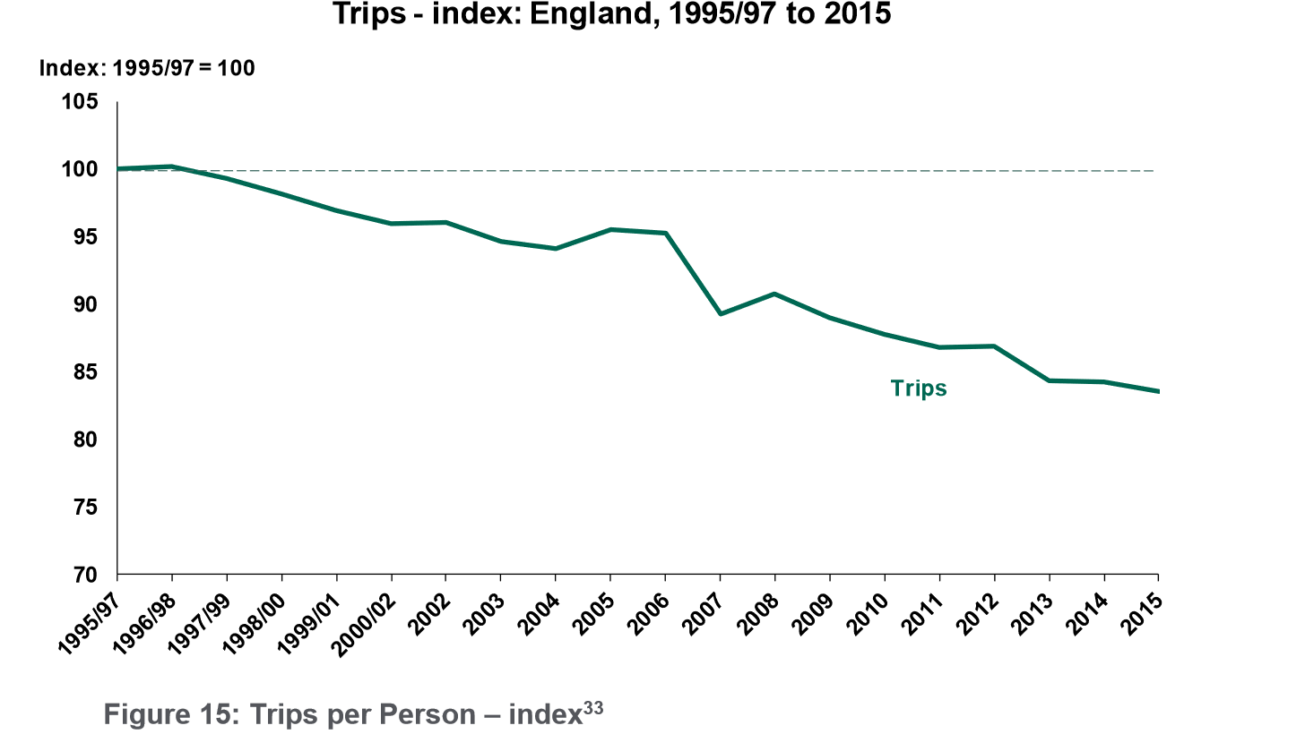
Changes in Travel Behaviour
Extrapolated Trip Rates (Scenario 6)
This scenario cites the evidence from the National Travel Survey (NTS) that demonstrates trip rates have been declining over the last 20 years, with a reduction in trip rates of 13% since 2002.

Slide 9
Moving away from Predict and Provide
Traditional transport planning has commonly used the “predict and provide” process using past trends to forecast the transport needs for the future.
This approach was not deemed appropriate in 1990s by DfT (SACTRA Report)
Trends show this approach to be even less relevant.
CIHT Futures in 2016 published “Uncertainty Ahead – Which Way Forward for Transport?” which set out key issues for the transport profession in light of uncertainty.
One of the key activities for planning for change in travel behaviour is scenario planning.

Slide 10
Scenario Planning
Uncertainty Ahead sets out the principles of scenario planning.
Scenario planning is contrasted with forecasting, which, while we commonly use in understanding the impacts of proposed developments, conceals uncertainty and gives misplaced confidence in the future.
Scenario planning enables us to ask the following three key questions:
  What sort of place are we creating?
  What kinds of activity do we need to travel for?
  How will we provide for mobility?
In asking and answering these questions we are moving to a “decide and provide” approach rather than the traditional “predict and provide” approach which takes as its base assumption that people will maintain past and current travel behaviour.

Slide 11
Scenario Planning and TRICS
In the transport assessment process, vision led thinking and scenario planning can be represented by setting out a range of the potential trip generation outcomes that could take place within a proposed development in the context of “what sort of place are we creating?”
This range of trip generation can include consideration of background growth scenarios (as seen in the RTF18 report) as well as the implications of high and low provision of sustainable transport measures.
The travel behaviour trends and trip reductions that have been presented in this document do not provide developers with an opportunity avoid implementing transport measures.
A range of potential trip generation arising from plausible scenarios could be represented as a trip rate fan - “Fan of Influence”
The scale of the development is an important consideration as to whether scenario planning is applicable.

Slide 12
Supporting Decision Makers
At the earliest stage decision makers; local authority officers and politicians need to be brought into the discussions surrounding the use of the “decide and provide” approach, the use of trends and scenario planning and the trip generation analysis.
The Transport Assessment Scoping meeting can be used to discuss and understand how the assessment will use “decide and provide” in place of “predict and provide”.
Presenting the case for the site is not just about numbers and impacts, it is about telling the story surrounding the assumptions, the scenarios, the validity of the approach from the DfT perspective.

Slide 13
Implications for TRICS - Summary
It seems plausible that trip rates, in particular vehicle trip rates in urban areas could become lower or plateau at current rates.
Exposing and accommodating uncertainty in socio technological, economic, environmental and political drivers becomes a key activity in the transport assessment process.
It appears that the national data trends are reflected at a local level in the TRICS historic data review.
Further trip reduction may be experienced on the local road network, dependent on the location of proposed site, that should be taken into account in the trip generation and distribution process.
If no recognition is given to trends shown in the evidence from All Change and the DfT RTF18 report then it is inevitable that transport planning will continue to provide infrastructure that meets previous predicted needs rather than the transport needs of the future. This runs the risk of stranded or underutilised assets.

Slide 14
User Group Discussion Questions
How can we accommodate the travel behaviour change evidenced in the trends analysis to inform vision led supply led demand development decisions?
How do we best present the evidence of the change in travel behaviour over time in transport assessments, using local and national trends information?
The trend information shown in the TRICS research and the All Change report can be used to formulate local policy, how can this information be used in the planning process?
What information will support decision makers taking forward the “decide and provide” approach?
What level of uncertainty in trip rates might mean a more flexible transport strategy for the site is required and what monitoring strategy would be required?

Slide 15
User Group Discussion Questions
What aggregation advice should be issued to users about different sites in different area types and regions?
What guidance should TRICS issue over variability of trip rates? Is variability more important under a decide and provide future than has previously been allowed for?
What research needs are there to understand the quite significant temporal shifts in trip rates for some use classes?
What scale and type of development would be best suited to scenario planning?
What further work needs to be carried out to understand the relationship between TEMPRO and TRICS?

